Slide 1

In-Warehouse Solution
[Insert Customer/Prospect Name and Logo]
[Insert Date]

Slide 2


First Last Name
Title
email@powerfleet.com
Insert presentation title

Slide 3









About Powerfleet
Intro – Our Approach
Challenges
The Desired State
Positioning Statement
Our Solution
Customer Stories
Agenda
Notes:
Provide a brief overview of what will be covered, highlighting the key points like the challenges, solutions, and expected outcomes.

Slide 4

About Powerfleet

Slide 5
7,500
Enterprise Customer Worldwide
1,800
Total Revenue
$285m
Powerfleet
by the Numbers
tenured and talented team members
continents with physical geographic presence
total subscribers worldwide
6
1.9 million
40
30+
Patents
Years of Experience

Slide 6
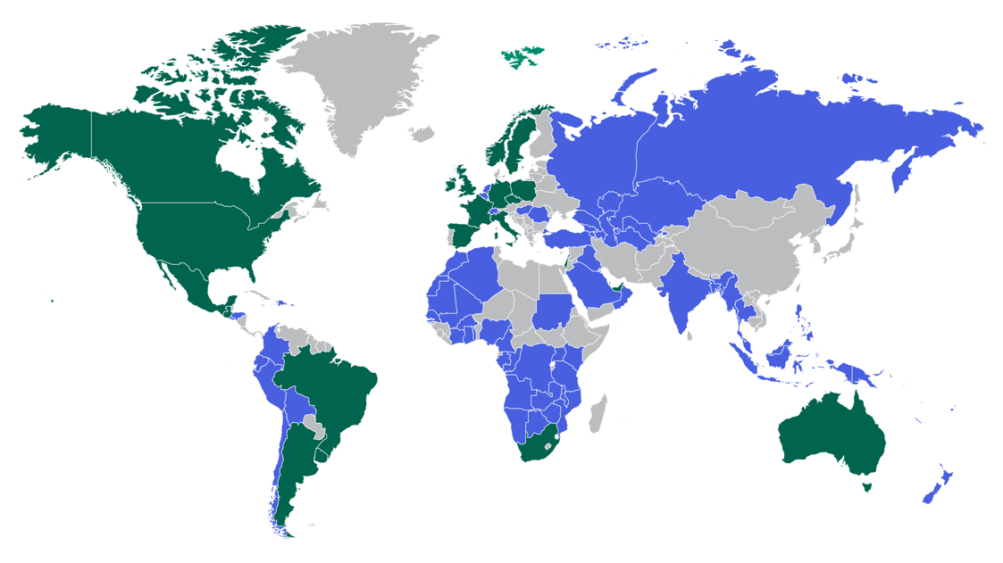
People-Powered AIoT with Global Scale
Europe
USA
Israel
Mexico
Middle East
Brazil
Australia
South Africa
Argentina
Direct Support
Partner Support

Slide 7





































Distribution
Transportation
Retail
Construction
7,500+
enterprise customers across a wide range of industries including Construction and Heavy Equipment, Distribution, Field Services, Leasing and Car Rental, Government and Public Safety, Manufacturing and Automotive, Oil, Gas, and Chemical, Transportation and Logistics, Utilities and Telecommunications, and Cold Chain Logistics
Automotive
CPG/Food & Beverage
Oil & Gas
Rental Car
Government
Utilities

Slide 8
A Mission-Critical Provider to Fortune 500 Companies Across Various Industries
Automotive
Retail
Construction
Food & Beverage
6 Out of the Top 10
7 Out of the Top 15
2 Out of the Top 4
8 Out of the Top 20
Transportation & Logistics
CPG
Oil, Gas & Chemicals
Manufacturing
4 Out of the Top 5
3 Out of the Top 8
11 Out of the Top 25
10 Out of the Top 20

Slide 9
Intro
Our Approach

Slide 10

We are People Powered AIoT
Helping our customers save lives, time, and money
People
At Powerfleet, we are all about people. Partnering with us means working directly with experienced, consultative, tenured, and talented people across your entire journey.
01
02
Platform
Powerfleet Unity, our fleet intelligence platform, unites people, assets, and IoT device data together on a single platform to transform the way you do business.
03
Partnership
Powerfleet is your reliable, strategic partner with you on your journey to true digital transformation. We help change agents like you realize more effective strategies and results.
Notes:
Intro - our approach
At Powerfleet, we aren't interested in just selling you devices - we are here for a lasting partnership
This means focusing on solving business problems
Ensuring we are providing you with a SOLUTION that will help you achieve these goals

Slide 11
Challenges

Slide 12



TODAY'S WAREHOUSE OPERATIONAL REALITIES
“
29%
Increase in trucking-related fatalities over the past decade
“
“
“
90%
of all forklifts will be involved in some type of accident during their useful lifetime
5,486
workers died from work-related injuries in 2022
668k to
1.9m
Warehouse & distribution employee increase 2011 to 2023
Source: FMCSA
“
70%
of warehousing businesses struggle to hire skilled workers
Source: U.S. Bureau of Labor Statistics
Source: OSHA
“
Source: OSHA
“
$44K
Average compensation
for workers injury
“
Source: Manpower’s Group Survey
Over
Forklifts caused
“
11%
of the forklifts in the US will be involved in an accident each year
7,290
nonfatal injuries in 2020
43%
employee turnover
dramatically exacerbated the safety risks in recent years
Source: NSC
Source: NSC
Source: OSHA
Source: Bureau of Labor Statistics
Notes:
Negative impacts of not addressing challenges
90% of all forklifts will be involved in some type of accident during their useful lifetime (According to OSHA)
668k to 1.9m Warehouse & distribution employee increase 2011 to 2023 (According to OSHA)
29% Increase in trucking-related fatalities over the past decade (According to FMCSA)
5,486 workers died from work-related injuries in 2022 (According to the U.S. Bureau of Labor Statistics)
$44K Average compensation for workers injury (According to NSC)
Forklift caused 7,290 nonfatal injuries in 2020 (According to the NSC (National Safety Council)
70% of warehousing businesses struggle to hire skilled workers (According to Manpower's Group survey) *the quarterly survey by the recruiting giant Manpower. The survey, covering 45,000 employers in 43 countries, unveiled that the largest EU economies are all seeing above-average hiring challenges.
https://go.manpowergroup.com/hubfs/MPG_MEOS_Q4_2021_Global_Report.pdf
43% employee turnover dramatically exacerbated the safety risks in recent years (According to the Bureau of Labor Statistics )
Over 11% of the forklifts in the US will be involved in an accident each year (According to OSHA)

Slide 13

TODAY'S WAREHOUSE OPERATIONAL REALITIES
“
25.7%
Fatal accidents in EU are due to uncontrolled machinery
“
“
“
22.7%
Of non-fatal accidents in EU are caused by impact with stationary objects
3,347
workers died from work-related injuries in 2021
2.1 million
EU manufacturing enterprises employed 30 million people in 2021
Source: eurostat
“
63%
of EU SMBs experience employee shortages due to labor and skills gaps
Source: eurostat
Source: eurostat
“
Source: euorstat
“
€476 Billion
“
Source: European Commission
90%
of forklifts are involved in an accident throughout the span of their lifetime
During 2021
“
31.2 %
EU non-fatal workplace accidents occurred primarily in industrial sites
Annual Cost of Work-Related Injuries and Illnesses in the EU
80%
of forklift accidents include a pedestrian
Source: EO-OSHA
Source: eurostat
Source: UK's Health and Safety Laboratory
Source: The European Commission
Notes:
Negative impacts of not addressing challenges
During 2021, 31.2 % EU non-fatal workplace accidents occurred primarily in industrial: https://ec.europa.eu/eurostat/statistics-
explained/index.php?title=Accidents_at_work_-_statistics_on_causes_and_circumstances
3,347 workers in the EU died from work-related injuries in 2021, with a significant number in industrial and storage sectors:https://ec.europa.eu/eurostat/statistics-explained/index.php?title=Accidents_at_work_-_statistics_o
€476 Billion is the annual Cost of Work-Related Injuries and Illnesses in the EU: https://osha.europa.eu/en/publications/international-comparison-cost-work-related-accidents-and-illnesses
During 2021, more than one-quarter (25.7 %) of fatal accidents at work in the EU resulted from losing control of a machine, tool or transport/handling equipment: https://ec.europa.eu/eurostat/statistics-explained/index.php?title=Accidents_at_work_-_statistics_on_causes_and_circumstances
During 2021, one of the common types of non-fatal accidents at work in the EU resulted from pimpact with a stationary object (22.7 %): https://ec.europa.eu/eurostat/statistics-explained/index.php?title=Accidents_at_work_-_statistics_on_causes_and_circumstances
63% of EU SMBs experience employee shortages due to labor and skills gaps.: https://commission.europa.eu/news/tackling-labour-and-skills-shortages-eu-2024-03-20_en
2.1 million EU manufacturing enterprises employed 30 million people in 2021.
https://ec.europa.eu/eurostat/statistics-explained/index.php?title=Manufacturing_statistics_-_NACE_Rev._2&oldid=502915
80% of forklift accidents include a pedestrian: (A study by the European Commission ) https://www.linkedin.com/pulse/how-automation-can-help-reduce-high-cost-forklift-europe-chauhan-1yere/
90% of forklifts are involved in an accident throughout the span of their lifetime (A study by the UK's Health and Safety Laboratory ) :https://www.linkedin.com/pulse/how-automation-can-help-reduce-high-cost-forklift-europe-chauhan-1yere/

Slide 14
EVERY 3 DAYS, A LIFE IS LOST TO MATERIAL HANDLING EQUIPMENT*
*IN THE UNITED STATES ALONE

Slide 15

Challenges in Warehouse Operations
Escalating Operational Demands
As business scales, increasing bottlenecks and longer turnaround times challenge the efficiency of warehouse operations.
Critical Labor Shortages
The growing gap in skilled labor availability is leading to rising labor costs and increased overtime, severely stretching operational budgets.
Elevated Accident Risks
A high incidence of forklift accidents compels the need for enhanced safety measures to protect workers and reduce liability.
Compliance Challenges
Staying compliant with ever-evolving safety regulations is crucial to ensure smooth operations and to safeguard your organization's reputation.
Operational Inefficiencies
Reliance on manual processes significantly slows operations and introduces errors, negatively impacting decision-making and operational visibility.
Disparate System Integration
The lack of seamless data integration across systems hampers effective real-time decision-making and limits operational transparency.
Balancing Cost, Productivity, and Safety
Continuously reducing costs while simultaneously boosting productivity and maintaining safety presents an ongoing strategic challenge.
Technological Adoption Hurdles
High upfront costs and lengthy implementation phases pose significant barriers to automation and the adoption of advanced technologies.
Notes:
Either use this or the next two slides

Slide 16
In-Warehouse Challenges
Growing Demands & Labor Shortages
Safety Risks & Compliance Demands
Escalating Operational Demands
As market demands intensify, pressure on warehouse operations escalates, leading to significant bottlenecks and extended turnaround times.
Elevated Accident Risks
With statistics showing high accident rates involving forklifts, prioritizing safety in your operations is more critical than ever to protect your workforce and reduce liability.
Critical Labor Shortages
The widening gap in skilled workforce availability is pushing up labor costs and increasing reliance on overtime, stretching operational budgets.
Compliance Challenges
Keeping up with safety regulations is not just about avoiding fines—it's about ensuring smooth, uninterrupted operations and safeguarding your reputation.

Slide 17
In-Warehouse Challenges
Operational Inefficiencies & Technological Barriers
Balancing Cost, Productivity, and Safety
Reducing Manual Processes
Reliance on manual operations not only slows you down but also introduces errors that can affect critical decisions and operational visibility.
Elevated Accident Risks
With statistics showing high accident rates involving forklifts, prioritizing safety in your operations is more critical than ever to protect your workforce and reduce liability.
Integrating Disparate Systems
The lack of seamless data integration across platforms can hinder real-time decision-making and obscure a clear view of your operations.
Compliance Challenges
Keeping up with safety regulations is not just about avoiding fines—it's about ensuring smooth, uninterrupted operations and safeguarding your reputation.

Slide 18

Inaction: What’s at stake?
Ignoring these challenges not only hampers efficiency but also exposes your operations to significant risks.
Increased Operational Costs
Failure to streamline operations can lead to escalated costs due to inefficiencies, repeated tasks, and extended downtimes.
Non-compliance Penalties
Failing to meet industry regulations can result in hefty fines and legal challenges, damaging your reputation and financial standing.
Decreased Productivity
Inefficiencies and outdated practices can drastically reduce productivity, affecting output and delaying delivery times.
Loss of Competitive Edge
Without adopting modern solutions, your operations may fall behind competitors, resulting in lost market share and diminished customer trust.
Elevated Safety Incidents
Neglecting safety enhancements increases the risk of workplace accidents, leading to potential injuries and higher insurance premiums.
Reduced Equipment Lifespan
Lack of proper maintenance and outdated equipment can lead to frequent breakdowns, necessitating costly replacements and repairs.

Slide 19
The Desired State

Slide 20
The desired state: Overcoming Key Pain Points
Save time, save money, save lives…
Safety compliance ​
enforce best practices (licensing, training and
certifications, inspections)
Coaching initiatives​
provide insights and scoring where they are needed most
Minimize unsafe environment​
proactively warn and interject in real-time
Capture incidents ​
including ownership, video evidence and event profiles
Right equipment ​
ensure its available when and where it is needed
Optimize maintenance ​
for supporting operations needs while minimizing costs
Right-size equipment and employees ​
to maximize shift performance
Energy costs​
contains costs to improve sustainability

Slide 21
Discover a Better Way To…
IMPROVE PRODUCTIVITY
CONTROL COSTS
PROTECT THE SAFETY OF YOUR PEOPLE

Slide 22
Positioning Statement

Slide 23

INTRODUCING THE POWERFLEET DIFFERENCE
Powerfleet transforms how warehouses operate
Our solutions offer real-time, real-world insights for all powered industrial vehicles, significantly optimizing safety, productivity and maintenance.
Leveraging advanced AI, we streamline compliance and drive operational excellence.
With our unified platform, organizations of any size can achieve a new standard of efficiency and cost-effectiveness.

Slide 24



Why Powerfleet?
Device Agnosticism
Ingesting data from multiple data sources, harmonizing and transforming the dataset, and delivering simply understood insights through a unified SaaS platform
02
One Stop Shop Across all Mobile Asset Types
Providing mission-critical solutions from warehouse to trailer to vehicle, allowing customers to consolidate suppliers and gain end-to-end visibility
01
Unified Operations
Comprehensive ability to improve performance of the asset, the individual in charge of the asset, and the business process
03

Slide 25













Our Unity Data Highway
Unity End-to-End AIoT Data Highway
All Industries, All Geographies, All Stakeholders
Distribution
Automotive
Transportation
Rental Car
Retail
Government
Food & Beverage
CPG & Other
Ingest Harmonize Simplify Consume
Unify Operations
Data
Ingestion
IoT Consolidation
One-Stop Shop
Modular AI Apps
Integrations
Harmonization
AI & Simplification
Ability to Consume in Different Mediums
Unifying Customers’ Business Operations
Any device
Device & data agnostic ingestion
Single pane
of glass & source of truth, all assets
AI data-powered modular enterprise apps
Unified Operations
Any Sensor
Powerfleet data
Forklifts
Visibility
People
Assets
Business Processes
3rd party data
Cars
Safety
HRIS
CO2 & ESG
ERP & CRM
OEM data
LCV’s
Sustainability
Payroll
Maintenance
TMS & WMS
Trailers
Any Data Source
Other data
Trucks
Compliance
Labor spend
Fuel cards
CRM
Fuel
Training
Compliance
Planning
Maintenance
Hours of Service
Insurance
Inventory

Slide 26

Data-Powered Enterprise SaaS Applications
Safety and Security
Enhance driver safety with real-time data for better decision-making and risk reduction.
Advanced Fuel Management
Control fuel costs and support eco-driving with intelligent fuel usage insights.
Sustainability
Empower your EV transition with Unity. Get data-driven insights for optimized fleet management.
Maintenance and Performance
Optimize asset maintenance with usage-based servicing to cut costs.
Regularoty Management and Compliance
Simplify compliance with automated workflows for timely, safe operations.
Visibility and Resource Management
Maximize asset and personnel efficiency, minimizing unnecessary expenditure.

Slide 27
Our Solution

Slide 28



PLAN
COMMUNICATE
EXECUTE
OPERATE
ADMINISTER
IMPROVE
Unified
Operations
& Services
Mobile Assets (Vehicle)
Platform integration with outside data sources optimize mobile assets, individuals operating the assets, and business processes
Business Process
(Company)
Individual
(Employee)

Slide 29




Use Case: Data Integrity
∙ Name
∙ ID
∙ Skill level
∙ License expiration
∙ Department
Customer
HRIS
Platform
Customer
CMMS
∙ Hour meter
∙ Checklist failures
∙ Diagnostics
Platform
Single source of truth Eliminates errors Reduces manual labor Real-time

Slide 30
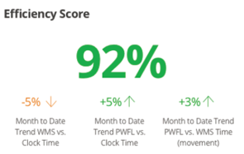
Use Case: Operational Efficiency
Payroll
Timeclock
ERP
WMS
Actual Activity

Slide 31


Use Case: Skill Progression
Skill
NOVICE
EXPERT
Safety Score
Performance
Notes:
Combining skill level rating with safety scores and performance statistics helps you determine who should progress to more advanced skill levels (any maybe shift priority or pay scale improvement), who should remain, and who many is regressing.

Slide 32







Use Case: Maintenance Predictability
Modeling hours of use to maintenance work tasks and associated time out of service (replacing tires, motor issues, battery replacement, brake fixes, horn replacement, hydraulic leaks)
Usage statistics
Inspection data
DTCs
Parts consumption
Impact data
Charge data
Temperature profiles
Mean Time Between Failure

Slide 33
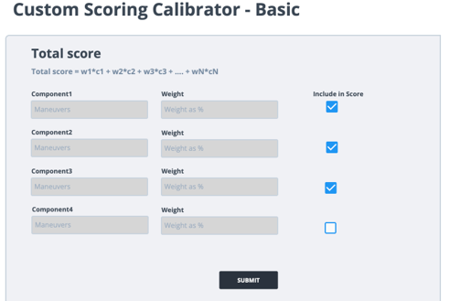

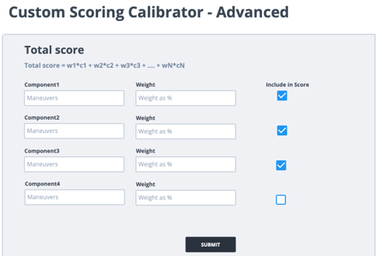
Dynamic AI Scoring
Total Score
Weight1
Weight2
=
*
*
…
Component1
Component2

Slide 34






Powerfleet Purpose-Built Solution For In-Warehouse
AI pedestrian proximity systems ​
help drivers avoid high risk situations through situational awareness and forced vehicle slow-down​
​Driver authorization enforcement
prevents uncertified vehicle use, limits vehicle speed by experience, and immobilizes unattended vehicles
Insights and driver performance
scoring to support coaching initiatives and optimize fleets
Integrated OSHA
recommended pre-use safety Inspections (DVIR)
​Impact tracking
with machine learning and DVR provides analysis of critical events without distracting false alarms
Maintenance planning
With CMMS integration makes fleets more available and cost effectively extends longevity

Slide 35





Benefits By Stakeholder
Maintenance/Fleet Managers
/ Rental Managers
Safety/Health/Environment (SHE) Managers / HR Managers
Industrial Engineers
Optimized workflow standards
Determining fleet mix
Reduced maintenance costs
Maximized uptime
Reduced lease overage and supplemental fleet handling
Avoid fines
Minimized risk
Reduced employee turnover, workers comp.
Reduced duplication
Data-driven performance evaluations
Operations Managers / Plant Managers
Technology Integration/Business Technology Integration
Operational Executives
Cost reductions and avoidance
More productive shifts
Directed coaching
Reduced disruptions
Unified operations
Pathway to automation
Reduced operational costs
Capital cost avoidance
Enterprise standardization
Reduced legal exposure

Slide 36
Customer Financial Benefits Summary By Industry
 | Retail Distribution |  | Grocery Distribution |  | CPG Mfg and Warehousing |  | Heavy Mfg and Warehousing
 | Improvement | Savings/Vehicle | Improvement | Savings/Vehicle | Improvement | Savings/Vehicle | Improvement | Savings/Vehicle
Assumptions
Daily Operating Shifts |  | 3 |  | 2 |  | 3 |  | 2
Annual Fully Fringed Labor Rate (2018) |  | $ 41,400 |  | $ 41,400 |  | $ 48,600 |  | $ 68,100
Areas of Benefit
Fleet/Equipment Reductions | 4% | $ 440 | 3% | $ 330 | 5% | $ 549 | 8% | $ 879
Scheduled Maintenance & Repairs | 6% | $ 204 | 6% | $ 136 | 3% | $ 120 | 3% | $ 112
Productivity Improvements* | 2% | $ 2, 757 | 1% | $ 919 | 3% | $ 4, 866 | 4% | $ 6, 055
Impact Related Vehicle Damage Reduction | 50% | $ 611 | 50% | $ 407 | 50% | $ 719 | 50% | $ 671
Impact Related Facility Damage Reduction | 50% | $ 1, 325 | 50% | $ 883 | 50% | $ 1, 559 | 50% | $ 1, 455
Streamlined Incident Investigation | 50% | $ 509 | 50% | $ 339 | 50% | $ 559 | 50% | $ 559
Electronic Pre-use Safety Inspections | 20% | $ 287 | 20% | $ 191 | 20% | $ 338 | 20% | $ 315
Total Annual Benefit per Vehicle |  | $ 6,132 |  | $ 3, 206 |  | $ 8, 749 |  | $ 10, 046
*Total Annual Benefit per Vehicle without Productivity |  | $ 3,375 |  | $ 2, 287 |  | $ 3, 883 |  | $ 3, 991
The above data represents the summary of annualized benefits realized by Powerfleet’s customers within 12-months of system launch and is the on-going/recurring financial benefits achieved. This data represents over 40,000 vehicles across 800+ customer locations.

Slide 37
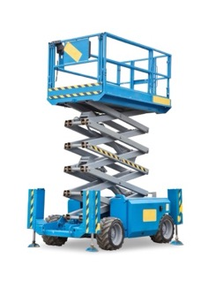
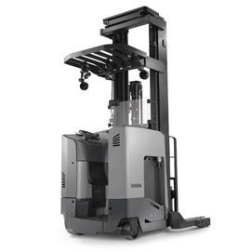
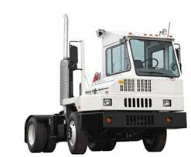
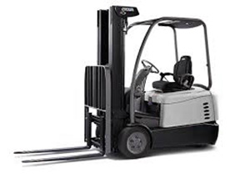
Optimizing All Your In-Warehouse Equipment
A Universal solution for ANY make/model/type of powered industrial vehicle
Powered Industrial Vehicles:
  Forklifts, Standups, Counterbalance, Powered Jacks, Walk/Ryder Pallet Jacks,
  Order Pickers, Tuggers and many more…
Man-lifts – Boom and Scissor
Scrubbers and Sweepers
Yard Tractors

Slide 38
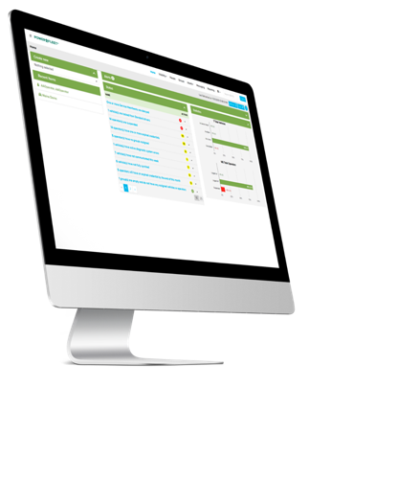
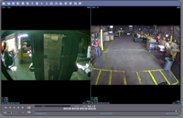
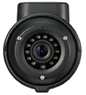
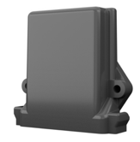
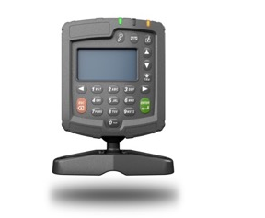

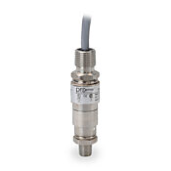
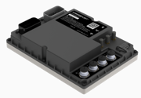
Features
System Overview
Access Control
Electronic Safety Checklist
Impact Management
Fleet Utilization
Preventive Maintenance
Text Messaging
Battery Monitoring
Automated Notification
On Demand & Scheduled Reporting
Pedestrian Proximity Detection
Speed management
Incident reconstruction
Location assessment
APIs

Slide 39
Software
Cloud App
Core Features
+ Features
Driver Setup
Pre-Trip Inspections
Impact Mgt.
Reporting
Pedestrian Incursion
Loaded/
Unloaded
Mapping
Enterprise KPIs & Dashboards
Fleet Setup
Realtime Operations
Text Messaging
KPIs
Mobile
EV Operations
Field Tools
Data Sources
Integrations
Configuration
VAC
AI Cameras
DVR
Customer Ingestion
APIs
SSO
SFDC
OEM CAN
Sensors
Batteries &
Chargers

Slide 40
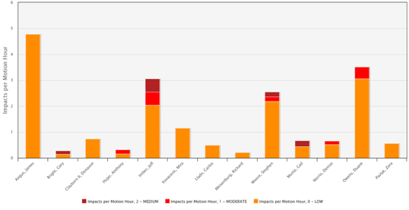
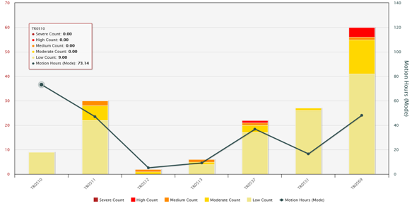
Reporting Examples
Impacts per Motion Hour by Operator
Jeff, Stephen and Duane are much more likely to have a significant impact event than the rest of the team members for each hour that they are operating a vehicle.
This could be process, physical surroundings, or simply operator attitude.
TR0531 and TR0569 have a much higher rate of events per motion hour than the other vehicles used by this work group.
This could be an issue with the vehicle, the process they used in, or the attitude of the primary operators of these vehicles.
Impacts per Motion Hour by Vehicle

Slide 41
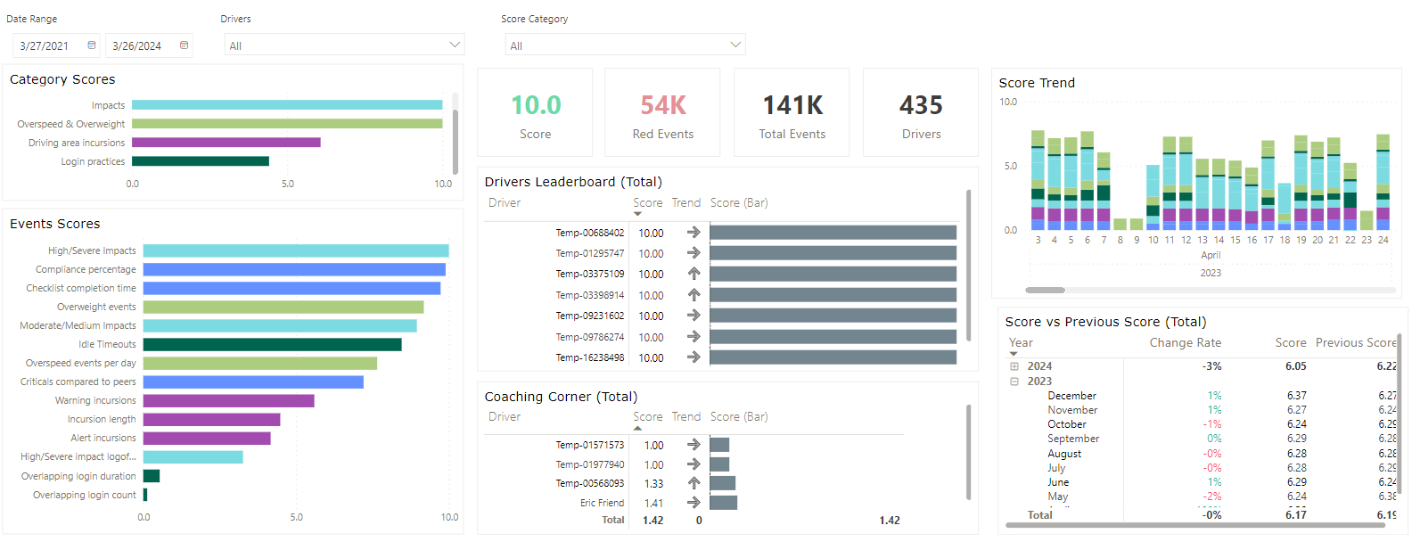
KPI Examples

Slide 42
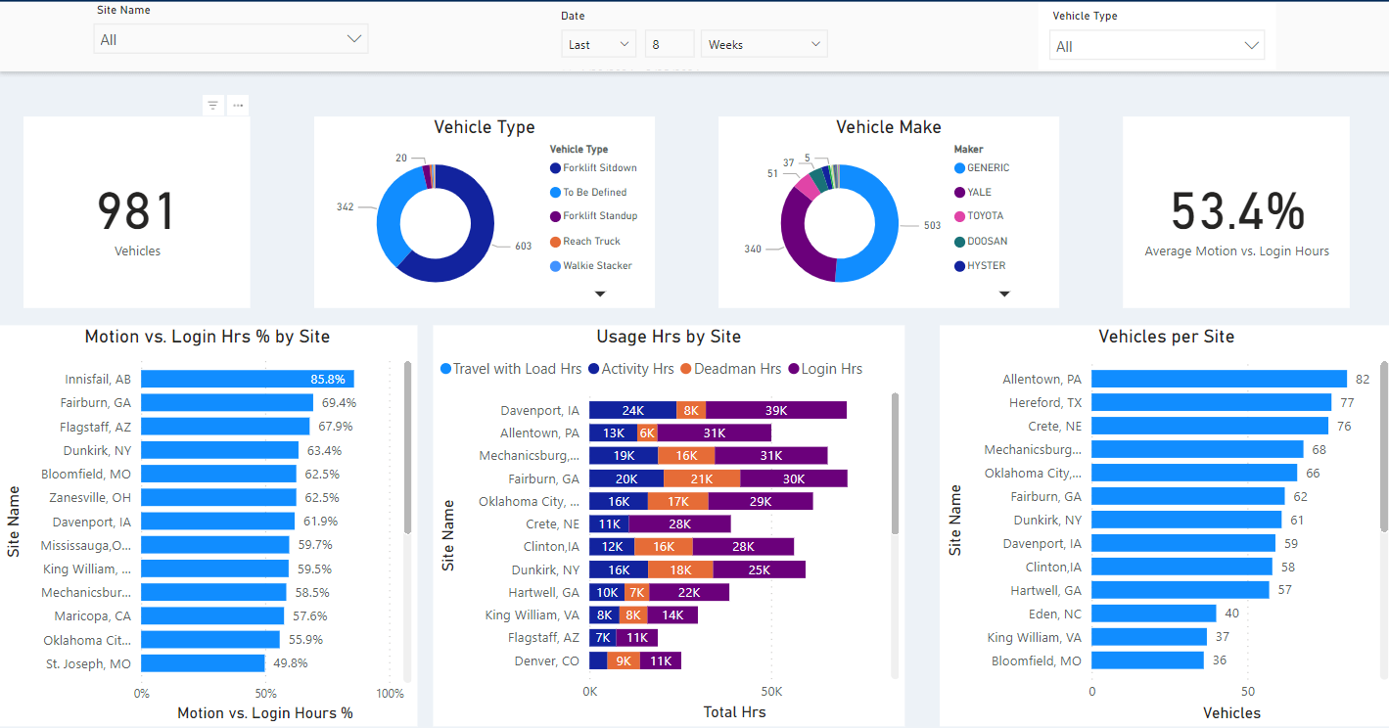
Enterprise Dashboard Example

Slide 43

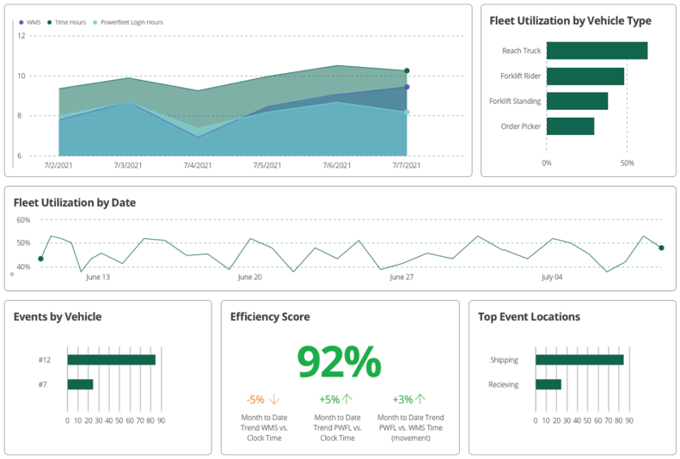
Data Unification Dashboard Example

Slide 44
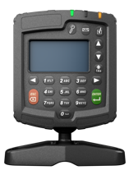

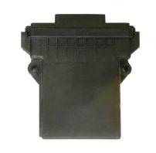
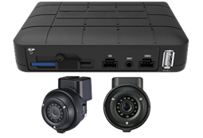
Solution Enablers
Forklift Gateway (VAC)
Pedestrian Proximity Detection
Digital Video Recorder
Speed Manager
Automated, wireless tracking and management for industrial vehicles and operators, seamlessly integrating into forklifts as a key part of fleet tracking systems.
AI edge processing vision system to help drivers avoid objects of interest in the path of travel while minimizing false alarms.
Rolling DVR that saves clips of interesting VAC events to rapid, accurate investigations.
Throttle/pedal override to slow vehicles down based on VAC or PPD events.

Slide 45
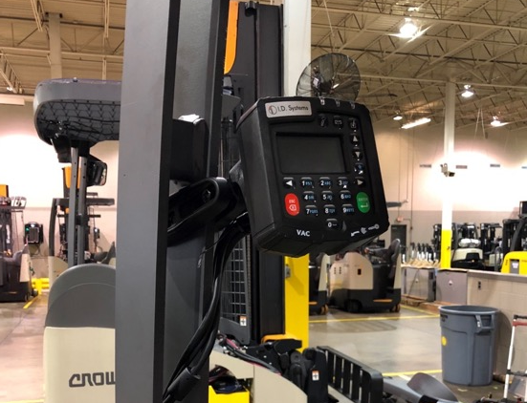
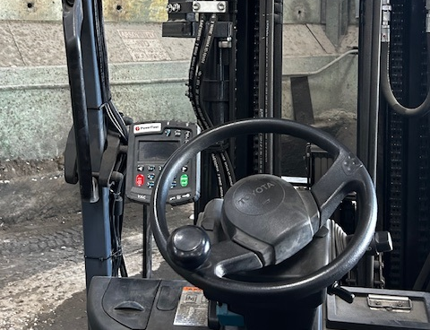
Telemetry – Forklift Gateway – VAC4
VAC4
VAC4

Slide 46
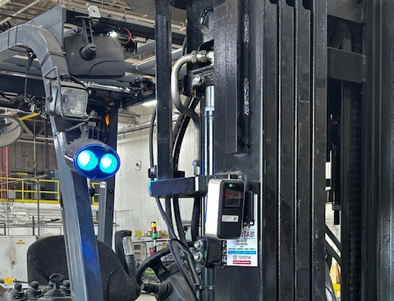
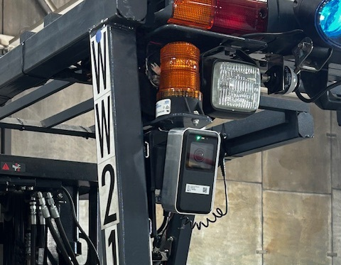
Pedestrian Proximity Detection
Front Camera
Rear Camera

Slide 47


Vehicle & Operator Access Control
Only authorized operators can use equipment
User configurations – which equipment they’re allowed to operate and when it’s allowed
Access levels set based on user experience level
Know who is driving what and when
Idle timeout by vehicle type
Automatic operator expirations for license, training certification
Reduces IC truck PMs/fuel use/emissions
Superior tamper resistance
Reader matches existing employee ID

Slide 48
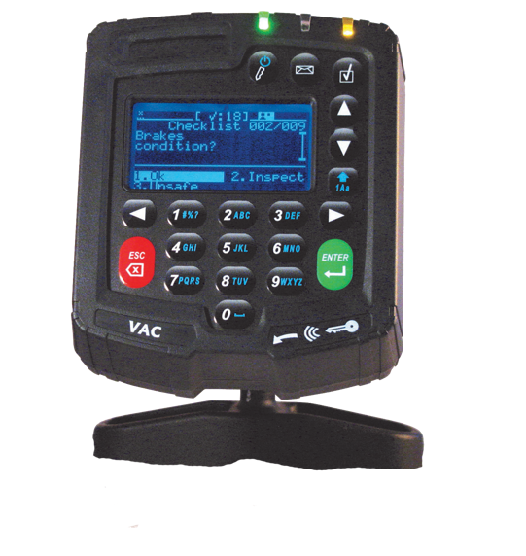
Electronic Safety Inspections
Benefits: Eliminate paper handling, regulatory compliance and improved maintenance.
Configurable
Event-based for most effective reactions
Reports prioritized by severity of problem
Severe impact triggers supervisor checklist
Moderate impact triggers driver self-checklist
Problem identified on main checklist triggers drill-down sub-checklist
Auto-notifications to maintenance/safety
Multi-language checklists can be triggered
Randomized answers (no ‘finger-whipping’)
Auto-verification of checklist answers that require vehicle to be motion (e.g. braking)
Prompt to stop/park vehicle safely before shutdown

Slide 49
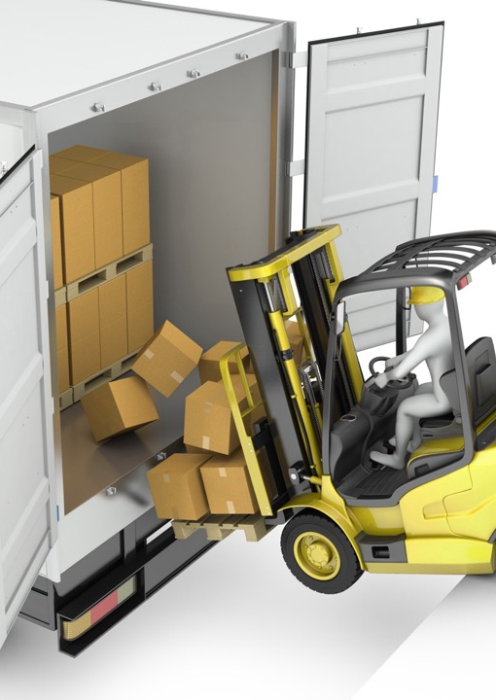
Impact Management
Benefits: Halo effect, reduced collisions, risk measurement, and investigation evidence.
Combination sensor leveraging accelerometers and other chips sets to detect movement and forces
Machine learning algorithm for automated calibration and continuous set point readjustment to optimize event creation and minimize nuisance alarms
Incident severity assignment with configurable post-event actions (lockout, emails/SMS, forced inspections, etc.)
Connected to external alarm for supervisor alert
Driver coaching [real-time event notification/feedback, leaderboard analysis]
“Black box” analysis of vehicle performance before, during and after impact

Slide 50
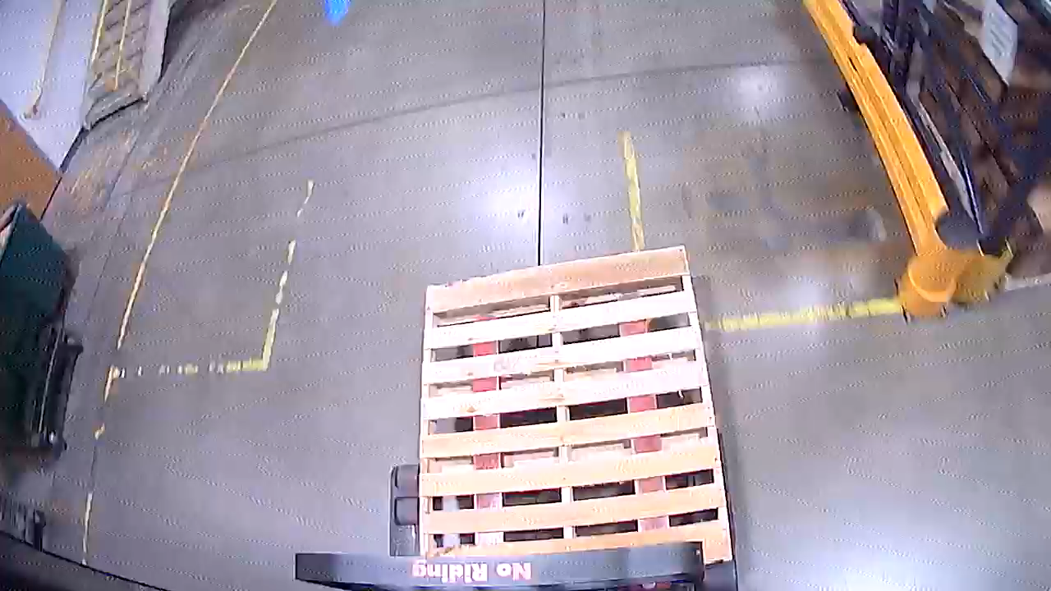
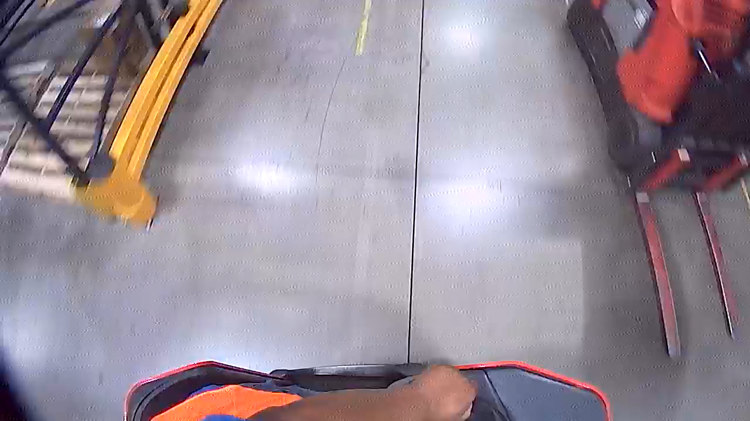
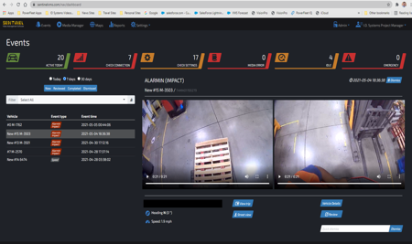
Impact Trigger – Vehicle to Vehicle Impact
Vehicle to vehicle impact – video and audio
Vehicle hits the parked truck
The PowerFleet external alarm goes off – Impact trigger is activated on DVR
The impact is recorded and upload to the cloud.
Notice the operator says everything is alright and keeps moving. Did not inspect for damage…
You can download the video as part of a report just like I dropped the MP4 file onto this presentation.

Slide 51

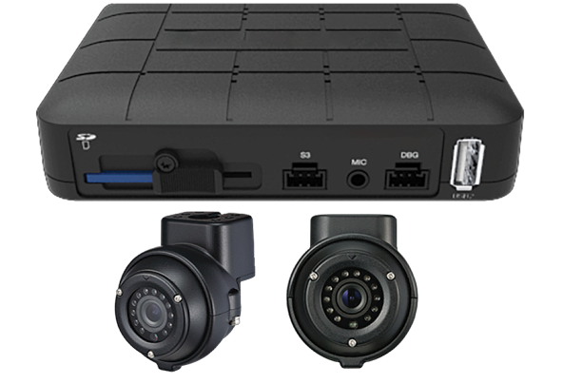
DVR
Benefits: Simplified investigations, indisputable proof of conditions and events.
Looping mobile DVR capturing video in front of and behind the forklift on an SD card
DVR collects before/after video clips when events (impact, speeding, driver prompt) occur
Connected to the Forklift Gateway (VAC) to trigger event clip information
Available driver assist display
Cloud connection option via Wi-Fi or Cellular to event review and live steam cloud application

Slide 52
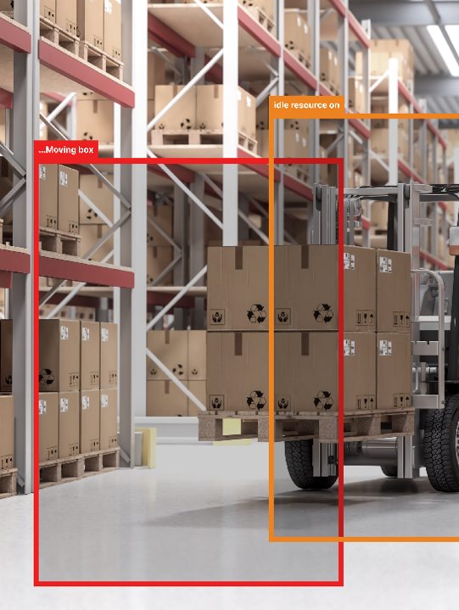

Pedestrian Proximity Detection
Benefits: Collision avoidance, increased pedestrian safety, and facility and driver risk assessment.
Artificial Intelligence vision-based system
Identified high risk objects (people and vehicles) in the path of travel
Warns drivers of object incursions
Connected to the Forklift Gateway (VAC) through a Sensor Hub
No wearables for infrastructure required!

Slide 53




Improving Risk Profiles
Directed coaching
Adjusting breaks and shift times
Adding barriers, signage or walkway paint where more impactful

Slide 54
What’s Your Risk Profile?
34 DAYS DURATION
2
Vehicles
5,922
Breaches
50M
Images Evaluated
351
Motion Hours
4.36
Hours of Breach Time
31K
Images of Breaches

Slide 55

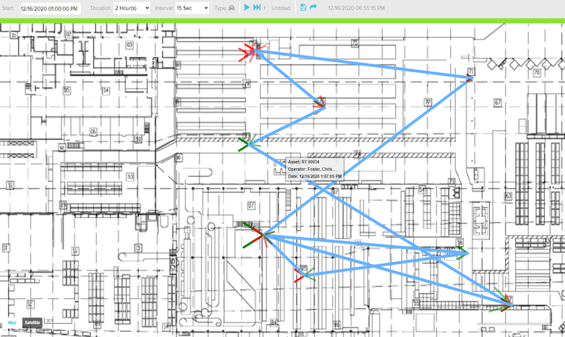
Powerfleet Enterprise: Visibility (WIFI and/or GPS)
View play back to understand what work areas a vehicle/operator traveled during a selected time period

Slide 56
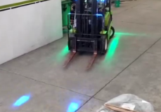
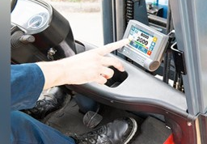
Other Solutions
Safety Lights
Solves problem of alerts in noisy environments
Prevents accidents in common scenarios: blind corners, cross aisles and exiting semi-trailers
Forklift Scales
Easy and accurate load verification
Weighing is quicker and more efficient than using a floor scale
Track weighing by truck number or product
Overload notifications

Slide 57




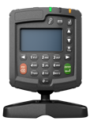
Customer Experience By Stakeholder
DRIVER
FLEET MANAGER
OPERATIONS
Log in to VAC
Complete inspection
Perform work tasks
Respond to events and alerts
Log out
Receive alerts
Inspect and unlock vehicles and drivers
Find vehicle
Implement performance upgrades based on reports and dashboards
Influence business change with data driven insights from reports and dashboards

Slide 58

Customer Stories

Slide 59




Walmart
Deployed Powerfleet’s in-warehouse wireless Vehicle Management System (VMS) for real-time tracking and management.
Integration of impact sensing and electronic safety checklists to ensure compliance and safety.
Utilized unique data analytics for optimizing fleet size and operator productivity.
Challenge
Walmart needed to enhance safety and productivity in managing over 100 industrial vehicles in their distribution centers.
Solution
CASE STUDY
Deployed Powerfleet’s in-warehouse wireless Vehicle Management System (VMS) for real-time tracking and management.
Integration of impact sensing and electronic safety checklists to ensure compliance and safety.
Utilized unique data analytics for optimizing fleet size and operator productivity.
The world’s largest retailer, Walmart, partners with Powerfleet to continue
to drive innovation and demand supply chain excellence.
Key Outcome
Significantly improved vehicle utilization and productivity.
Enhanced safety and reduced operational costs.
Streamlined operations with real-time vehicle tracking and management.
Enhanced safety and reduced operational costs across multiple distribution centers.
Provided scalable solutions that improved decision-making and resource allocation.
Notes:
https://www.powerfleet.com/casestudies/walmart-spearheads-another-best-practice-in-supply-chain-execution/

Slide 60
Xerox
Deployed Powerfleet’s in-warehouse wireless Vehicle Management System (VMS) for real-time tracking and management.
Integration of impact sensing and electronic safety checklists to ensure compliance and safety.
Utilized unique data analytics for optimizing fleet size and operator productivity.
Challenge
Xerox needed a solution to improve safety and compliance in its key distribution center in the US handling various industrial vehicles.
CASE STUDY
Solution
Implementation of Powerfleet’s in-warehouse Vehicle Management System (VMS)
Advanced access control ensures only certified operators can access vehicles, with easy restriction adjustments for non-compliant operators.
Replaced manual, paper-based checklists with an automated, electronic system that ensures real-time compliance and reduces storage needs.
Xerox Corporation, the world’s leading document management, technology and services enterprise, partners with Powerfleet to enhance supply chain efficiency at its key distribution center, responsible for distributing over 70% of Xerox equipment nationwide.
Key Outcome
Achieved 100% compliance with pre-shift checklists through automation.
Enhanced safety and operational efficiency by ensuring proper vehicle use and fast issue resolution.
Management can now instantly access compliance reports and lock out vehicles electronically, greatly reducing the time and physical effort previously required.
Notes:
https://www.powerfleet.com/casestudies/xerox-increases-safety-and-industry-vehicle-use-with-powerfleet-vehicle-management-system/

Slide 61
Continental Tire
Deployed Powerfleet’s in-warehouse wireless Vehicle Management System (VMS) for real-time tracking and management.
Integration of impact sensing and electronic safety checklists to ensure compliance and safety.
Utilized unique data analytics for optimizing fleet size and operator productivity.
Challenge
Continental Tire needed to reduce vehicle damage and improve safety in its large tire manufacturing and warehousing operations.
CASE STUDY
Solution
Implemented Powerfleet's in-warehouse solution for enhanced operator accountability, safety compliance, and data analysis.
Introduced operator-specific access controls for vehicle operation by trained personnel only.
Automated daily vehicle checklists to ensure compliance and swift issue resolution.
Continental Tire, a major manufacturer and distributor of tires for passenger, light truck, and commercial vehicles, partners with Powerfleet to optimize vehicle management at one of their largest manufacturing centers, which handles the entire tire development process from design to delivery.
Key Outcome
Achieved a 33% reduction in vehicle-related damage costs.
Eliminated underutilized vehicles, achieving over $100,000 in savings with an optimized fleet size.
Fleet reduction targets achieved in 4 months, with ROI realized within a year.
Boosted maintenance efficiency with Powerfleet’s module scheduling maintenance based on actual vehicle use.
Notes:
https://www.powerfleet.com/casestudies/continental-tire-reduces-fleet-increases-safety-with-powerfleet-vehicle-management-system/

Slide 62
Kautex
Deployed Powerfleet’s in-warehouse wireless Vehicle Management System (VMS) for real-time tracking and management.
Integration of impact sensing and electronic safety checklists to ensure compliance and safety.
Utilized unique data analytics for optimizing fleet size and operator productivity.
Challenge
Kautex needed to enhance safety, productivity, and equipment utilization across their global operations, managing a substantial fleet of industrial vehicles.
CASE STUDY
Solution
Kautex designs, develops, and manufactures innovative solutions for the automotive industry, including smart fuel systems and advanced cleaning solutions for new mobility. Operating in over 14 countries, Kautex is committed to driving the future of the automotive sector. Kautex partners with Powerfleet to enhance global fleet management and safety.
Deployment of Powerfleet’s in-warehouse solution across multiple sites worldwide.
The system offers vehicle access restrictions, impact sensing, and electronic safety checks, enabling better management and tracking of industrial vehicles.
Key Outcome
Fleet size reduced by over 10% at initial sites, achieving significant cost savings.
Enhanced safety and reduced incidents, accidents, and equipment damage through better fleet management.
Improved decision-making with aggregated data across facilities, driving greater operational efficiency and modernization.
Global scalability of the telematics solution supports diverse geographical operational needs.
Notes:
https://www.powerfleet.com/press-releases/2022/02/kautex-expands-adoption-of-Powerfleet-telematics-solution/

Slide 63
“
Powerfleet’s solution delivered not only the promised safety and control benefits, but also significant incremental productivity improvements, above and beyond what our WMS was providing.
Supply Chain Executive, Walmart

Slide 64

“
Since deploying Powerfleet’s solution across our industrial fleet, we have seen a reduction in impacts, accidents, and damage to equipment and goods. We have gone from adopting the solution at a single site to more than eight locations across the globe with plans for continued deployments. The key to making our new deployments so successful has been Powerfleet’s global presence and its ability to work with us in multiple geographies. This along with Powerfleet’s easy-to-use software played a major role in our decision to grow our partnership with Powerfleet.
Global Director Material Excellence, Kautex

Slide 65


Testimonial Video
Customer: Cisco Systems & DB Schenker

Slide 66

Implementation and
Rollout

Slide 67

Solution Building Blocks
ENABLERS
Gateways, peripherals and sensors, cameras, site kits.
Core apps, value added features, data powered apps, APIs, hardware extended warranty
Installations and training, program management, launch support
SAAS
SERVICES

Slide 68



Pedestrian Bundle
Quoting – CPQ Bundles
Vehicle Kit
SaaS Core
Gateway Bundle
SaaS Core
Site Kit
Vehicle Kit
Speed Manager
Site Kit
One time services
DVR Bundle
One time services
Sensors
Vehicle Kit
Added Software SaaS
Other Bundles
Added SaaS
Speed
Weighing
Lights
SaaS Core
One time services

Slide 69



Service Overview – Installation & Implementation
Implementation
Management
Installation
Services
Training

Slide 70
Implementation
Customer journey – Implementation Milestones
Project Scope
Data Collection
HW Installation
Monitoring
Review scope,
order, stakeholders
Asset Info, SW Users, etc.
Asset Installation
Milestone
description
Kick Off Mtg.
Schedule
Training
Project Close
Present and initiate project plan
Lockin Milestone
dates/plan
User and
SW training
Turnover to Support/
Customer Success
PROJECT
START
Software Allocation
Install Readiness
Go Live
License Set Up
WiFi, badges, hardware shipments
Enable full access control (where applicable)
Contract Closed
1
2
3
4
5
6
7
8
9
10
11
Support
& Benefit
Phase I
Phase 2
Phase 3
Phase 4
INITIATE
PLAN
IMPLEMENT
POST LAUNCH

Slide 71
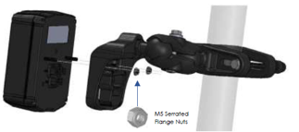


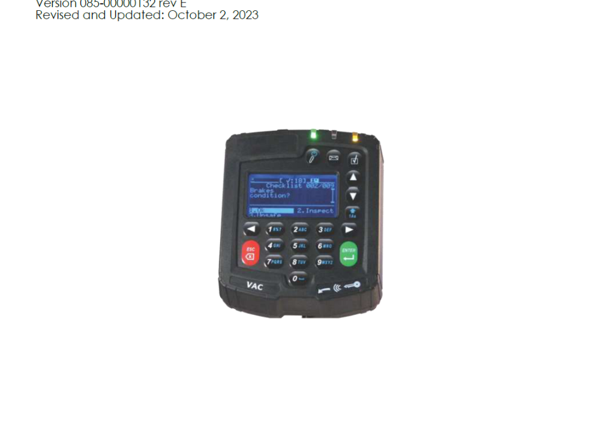

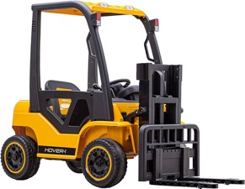



Wire Connections
Installation
Vehicle Gateway (VAC) 1.5 to 3 hours install
Pedestrian Proximity Detection 2 to 3 hours install
DVR
1 to 2 hours install

Slide 72
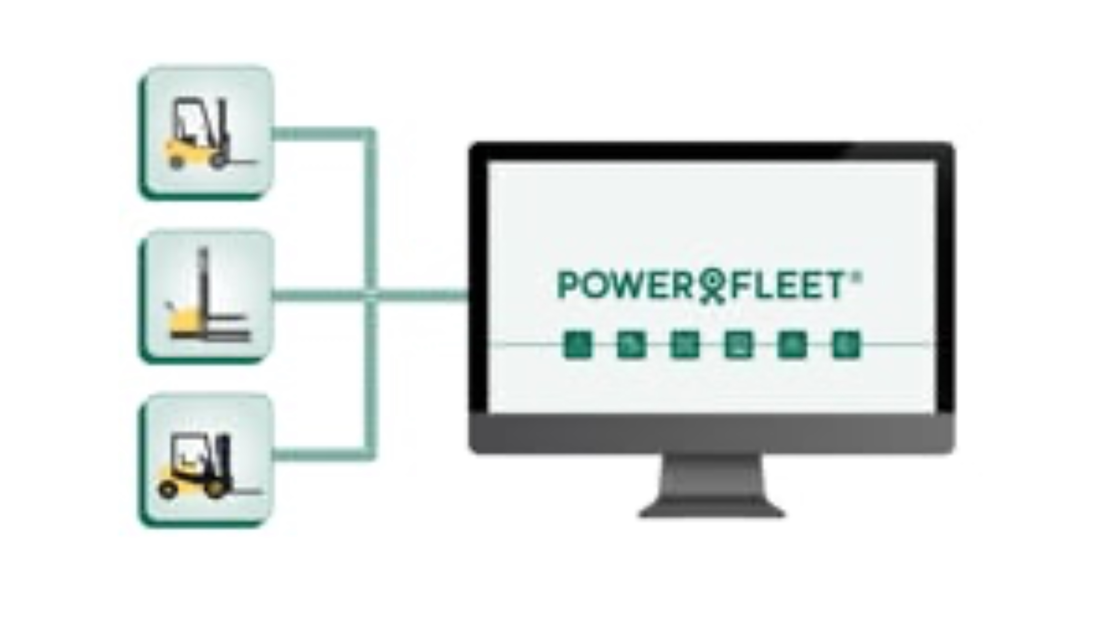
In-Warehouse Video

Slide 73


Pedestrian Proximity Detection Video

